Slide 1

Driver Drowsiness Detection System
Aditya (18csu011) Aman(18csu015)
Deepanshu (18csu059) Devesh(18csu061)

Slide 2
Drowsy Driving Problem
Drowsy Driving is the dangerous combination of driving and sleepiness or fatigue
It has been estimated that drowsiness causes between 10% and 20% of traffic accidents, causing both fatalities dead and injuries, whereas within the trucking industry 57% of fatal truck accidents are caused by this problem .

Slide 3
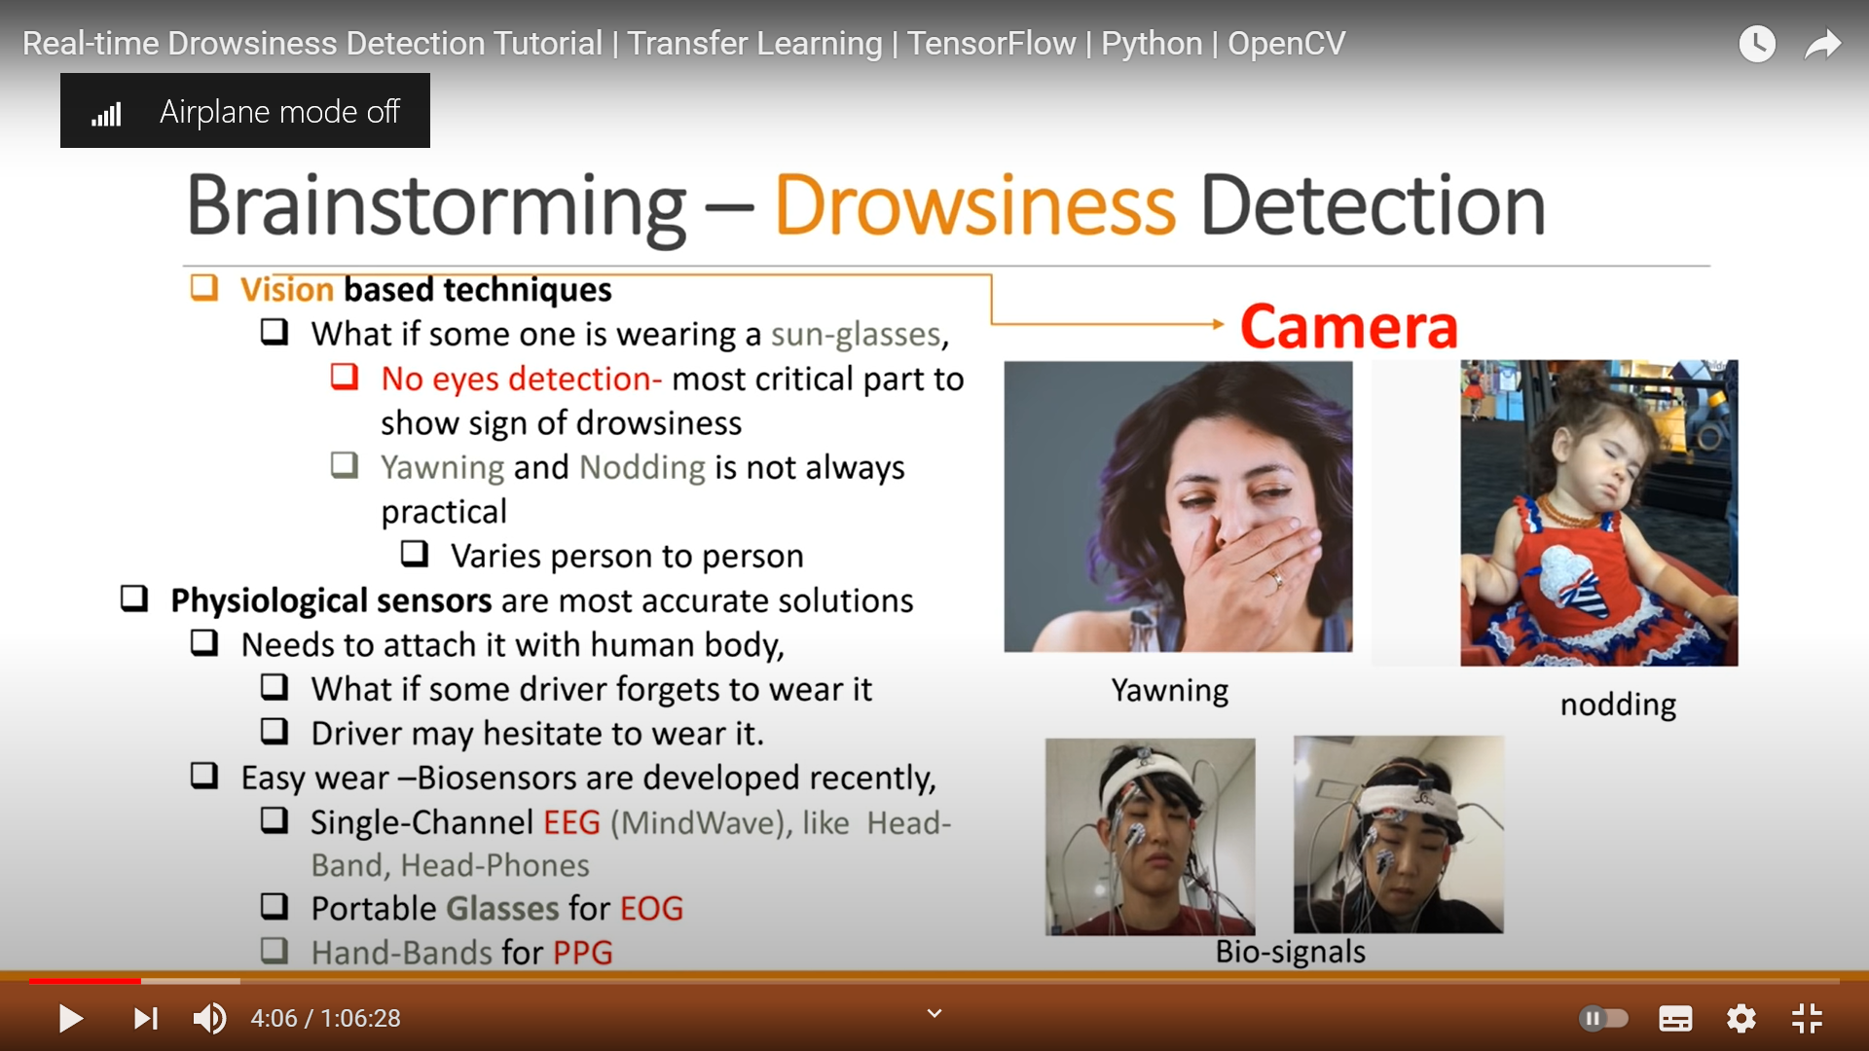
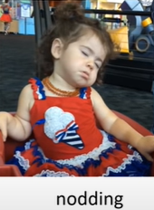
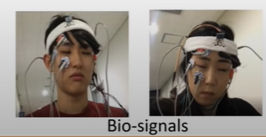
Drowsiness Detection
Vision Based technique
Eyes detection –most critical part to show sign of drowsiness
Yawning and Nodding is not always practical ,It varies from person to person
Physiological sensors-
Easy wear biosensors are developed recently(Head bands, Head-Phones)
Portable glasses of EOG

Slide 4
Goal
The main aim of this is to develop a drowsiness detection system by monitoring the eyes;
Labelled only two classes , Based on eyelid-closure
Sleepy(Eyes closed consistently)
Active(Eyes open consistently)

Slide 5
Dataset
We have2000 images of MRL Eye dataset, the large-scale dataset of human eye images.
This dataset contains infrared images in low and high resolution.
Out of 2000 fix 1400 images for training purpose and 600 for testing purpose.
Make 2 separate folder “Open_eye” and “closed_eye” having 1000 images in each folder

Slide 6
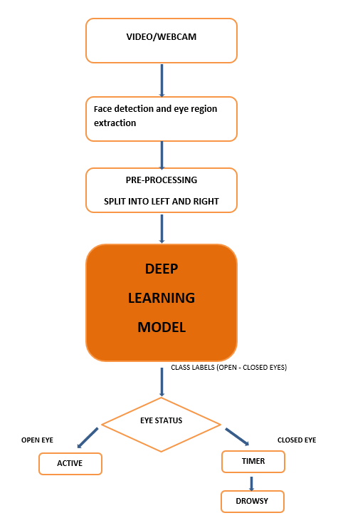
Architecture
The proposed architecture of Drowsiness detection system is -
1. Deep Neural Network
The proposed model has five phases -
1. Video/webcam
2. Feature extraction
3. Pre-processing
4. Model Building
5. Eye status: - 5.1 open eye 5.2 closed eye.

Slide 7
Methodology
Video/webcam:- This process requires a camera to continuously capture the image of the face of the driver. Several portions of the face can be used to detect consciousness level. Analyzing eye blink rate, eye aspect ratio, eye closure time, etc. are some popular methods. This kind of system can warn if the observed result is anomalous to the prescribed value
Feature extraction:- this session we extracting two features face detection and eye region extraction. Haar cascade classifier was used and implemented using OPEN CV with python. Haar cascade classifier uses Haar features for detecting the face from images. the Eye region images extracted from the face image
Pre-processing:- It is the part of methodology where eyes are split into left and right but make sure that both the eyes are either closed or open . All this done with the help of Haar Cascade Classifier which is just an object detection algorithm.

Slide 8
Methodology
Model Building:-The use transfer learning with deep learning based on repurposing the pre-trained model for a new problem and apply Fine-tunning transfer learning technique our model according by using mobilenet pretrained model.
Eye status: - In which two cases
Open eye- If a driver’s eye Keep open it means driver is not drowsy
Closed eye-If a driver's eye behave normal blinking rate it means driver is drowsy and not in active state and it will generate an alarm

Slide 9
Transfer Learning
Transfer learning is a machine learning technique where a model trained on one task is re-purposed on a second related task
In this use Pre-trained Model Approach
Select Source Model. A pre-trained source model is chosen from available models. Many research institutions release models on large and challenging datasets that may be included in the pool of candidate models from which to choose from.
Reuse Model. The model pre-trained model can then be used as the starting point for a model on the second task of interest. This may involve using all or parts of the model, depending on the modelling technique used.
Tune Model. Optionally, the model may need to be adapted or refined on the input-output pair data available for the task of interest.

Slide 10
Mobilenet classifier
MobileNet is a CNN architecture model for Image Classification and Mobile Vision.
It uses less computation power to run.
paired with transfer learning and high efficiency it significantly increases the accuracy and overall performance.

Slide 11
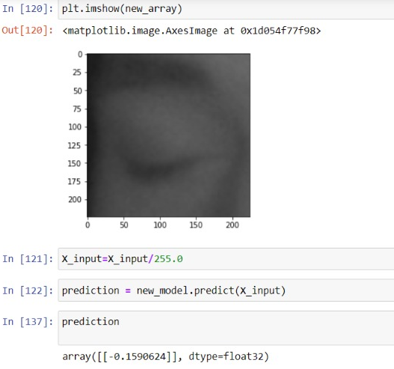
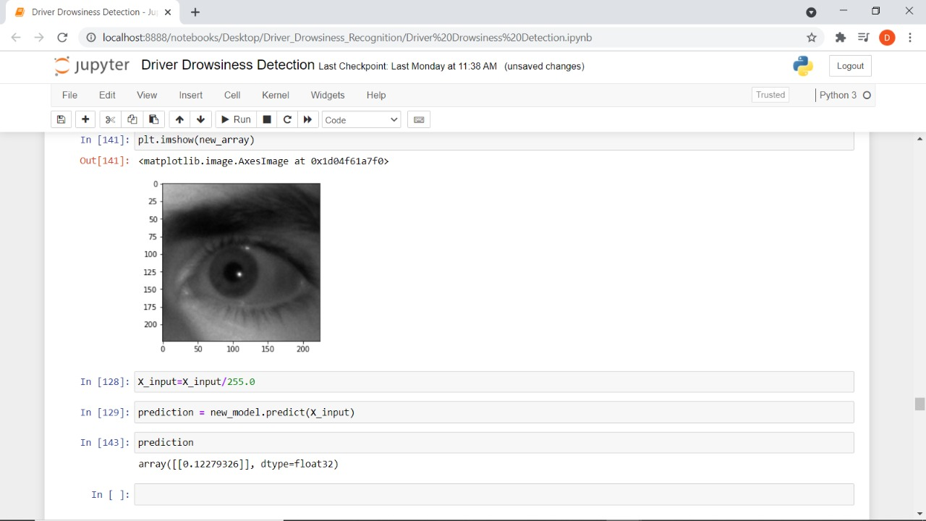
Result/Outcome
Case 1:- captured eye images pass to our model checking for prediction If a driver's eye keeps close for 3 to 4 seconds it is believed that driver is drowsy shown by numpy array by negative indexing
Case 2:- captured eye image pass to our model checking for prediction If a driver’s eye keeps open Or less blinking rate that means driver in active state (not drowsy) shown by positive indexing

Slide 12
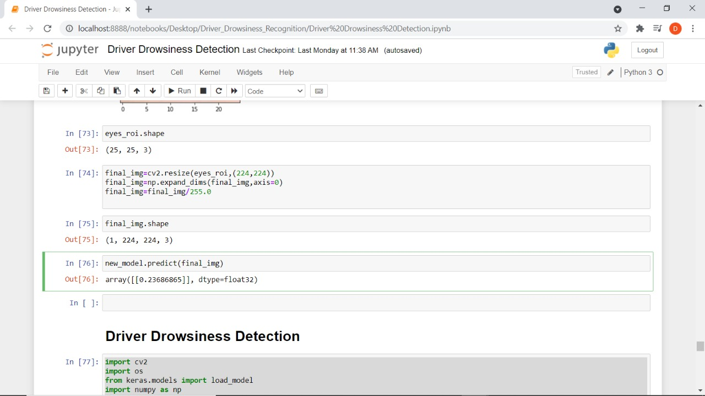
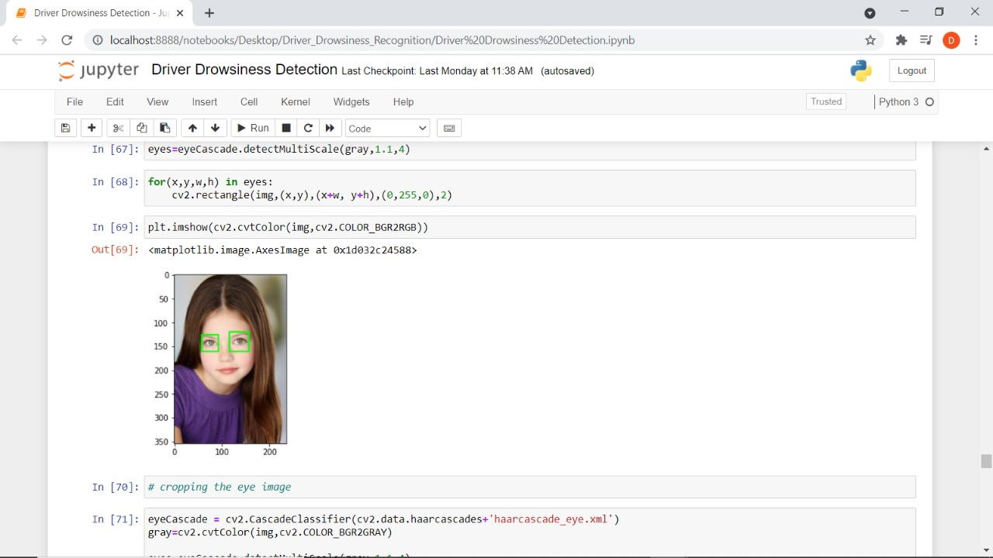
Result/Outcome
Case 3:- Captured Face images pass to our model Firstly Face detection and eye region extraction technique apply of our image this extracted eye image check If a driver eye keep open then numpy array pass positive indexing value otherwise driver eye keep closed then numpy array pass negative indexing value

Slide 13
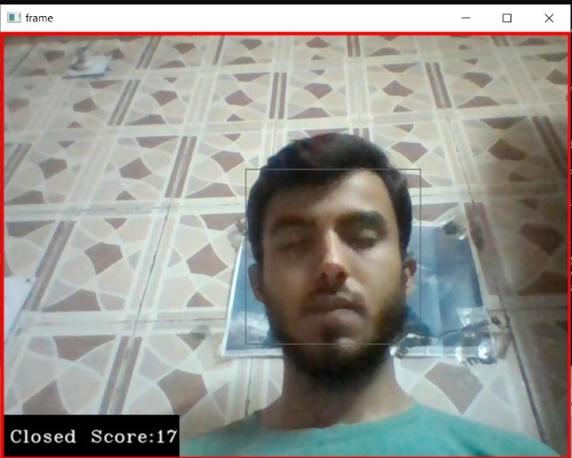
Results/Outcome
In Case of Videography If a driver's eye keeps close for 3 to 4 seconds it is believed that driver is drowsy and not in active state and it will generate an alarm

Slide 14
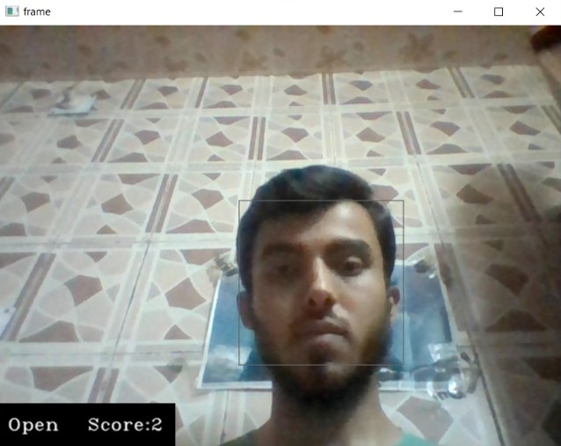
Results/Outcome
If a driver's eye behave normal blinking rate it means driver is drowsy and not in active state and it will generate an alarm

Slide 15
Conclusion
We conclude that fatal accidents can be avoided by using such advanced systems, which help regain consciousness within time. Technique used include, eye closure time and total eye blink (greater than 3 second based on the facial landmark). Eye closure time was used to compare with a standard value in normal physical condition. The total eye blink per minute is recorded then compared according to the different time of day. If any of the above methods is unsatisfied then the system decides the driver is unconscious.

Slide 16
Future Prospects
In the future, we look forward to integrating this system into an android app to make it easily accessible for all. Then the complexity of implementation will be alleviated, and it will be portable. Also, paired with a portable IR camera it will be possible to run the system at night times also.

Slide 17

Thankyou

